Slide 1

HUMAN-AI COLLABORATION IN GENERATING CALMING ART FOR HOSPITALS
Using both pretrained & scratch-trained models

Slide 2
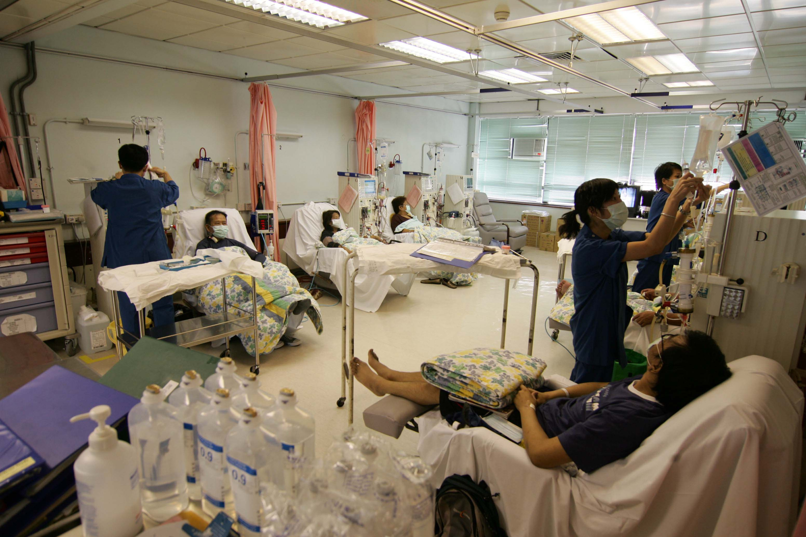

Slide 3
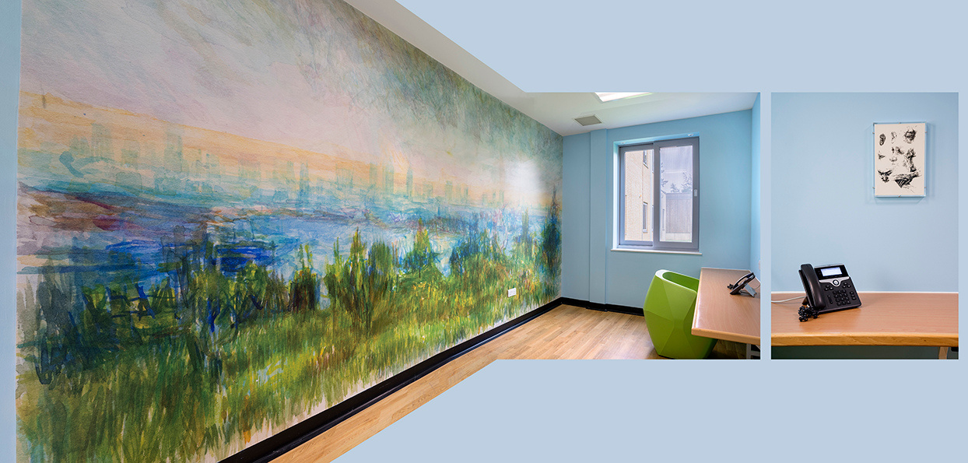

Slide 4

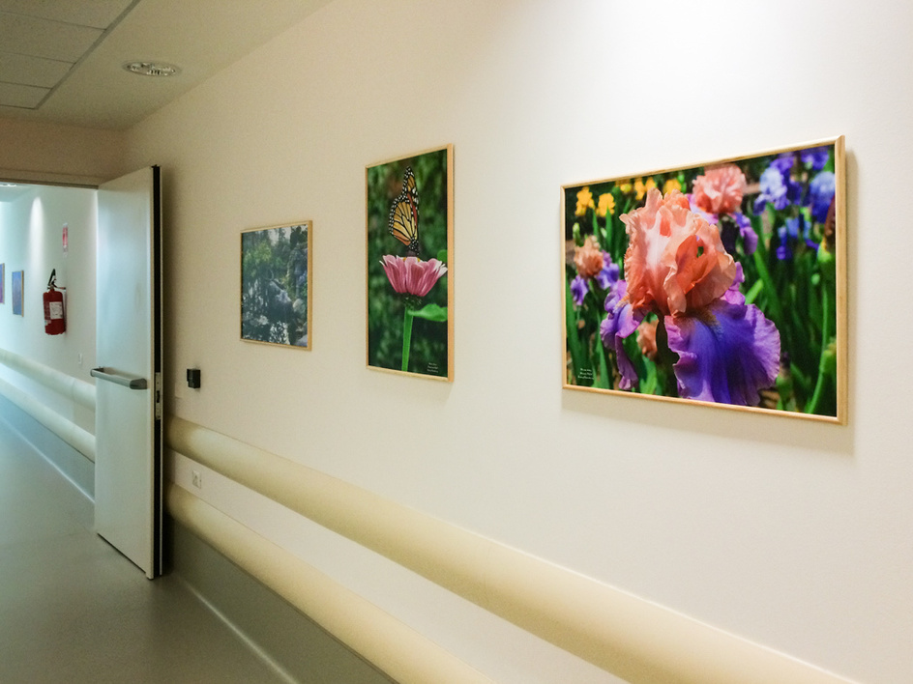
Why hospital art?
(1)
Dr. Staricoff's research project: ( 91 patients of ages between 20-90)
-80% reported that art improves mood
-47% found art effective in distracting themselves from medical worries
(2)
Arts in healthcare report:
-enhance their sense of safety
-physical environment can reduce patient stress
-improve the caregiver’s well-being.
(3)
Problem
-The artist had voiced doubts about the safety of the work
Staricoff, J., (2016). The Chelsea and Westminster Hospital arts programme: Evaluation report. London, UK
(1)
(2)
Rollins, J., Sonke, J., Cohen, R., Boles, A., & Li, J. (2009). State of the field report: Arts in healthcare 2009. Washington, DC: Society for the Arts in Healthcare.
(3)
Aston, J. , 2007 Public art online: The leading public art resource. Public Art Online Resources - Advice for the healthcare sector - When the Architects Leave: Maintaining artwork in the hospital environment.

Slide 5
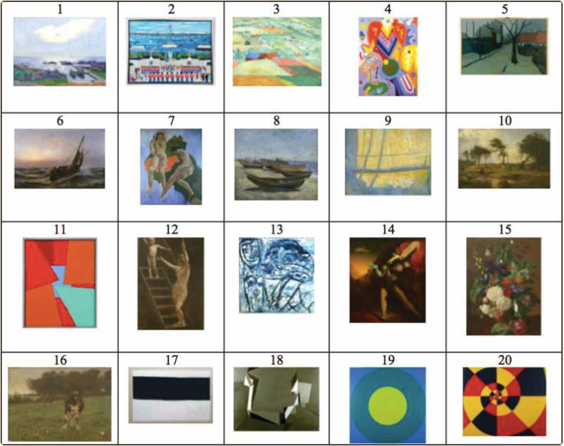
What makes certain art calming for people?
(1)
A study conducted by national library of medicine on 103 patients shows:
out of 20 artpieces picked by professionals as calming art, patients selected 1,2,3,5 and 20 as the preferred pieces
4/5 were landscape with one exception
(1)
Nielsen, S. L., Fich, L. B., Roessler, K. K., & Mullins, M. F. (2017, December). How do patients actually experience and use art in hospitals?

Slide 6

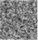
What methods are used? Why?
Method 1:
pretrained
image synthesizer
Method 2:
scratch-trained GAN
Method 3:
scratch-trained CycleGAN
A
B
TEXT
A
B
TEXT
AI
AI
AI
x N
noise

Slide 7
The types of AI that I am using
AI
AI
AI
hj
(2) AI vision
(3)
neural network (GAN)
(1) AI image generator
hbkhkhj
AI
AI
AI
AI
AI
AI
AI
AI
AI
TEXT
Description

Slide 8
What is GAN?

Slide 9




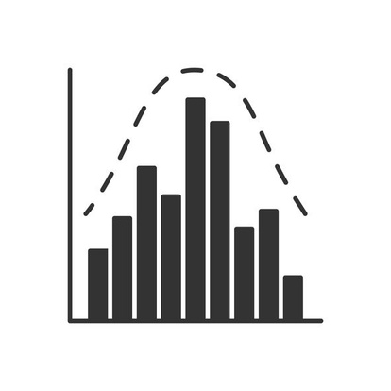
(1) research characteristics
(2) prompt engineering + text-to-images;
(3) selection
(4) GAN-based AI generation
(*) assessment and insignts
AI generated images
+500
+500
image set 2
AI generated images
calming elements
keywords
image dataset
image dataset
assessment
AI
AI
AI
AI
AI
AI
AI
AI
AI
AI
AI
AI
GAN
Cycle
GAN
AI rate the images
information arranged in table
AI generated images
keywords
+500
image dataset
3 methods for image generation

Slide 10
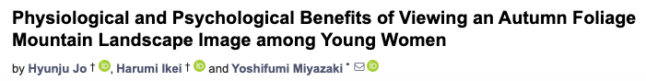
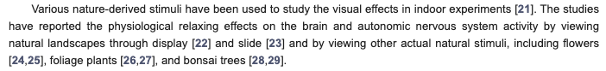
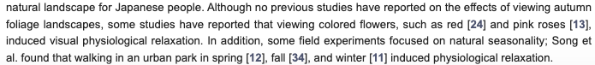
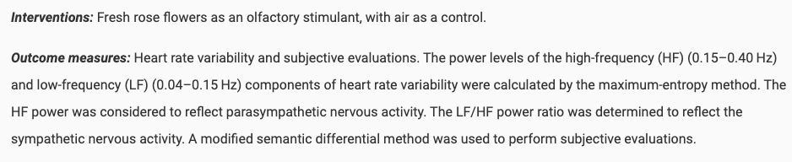
evidence that shows that certain elements are calming

Slide 11
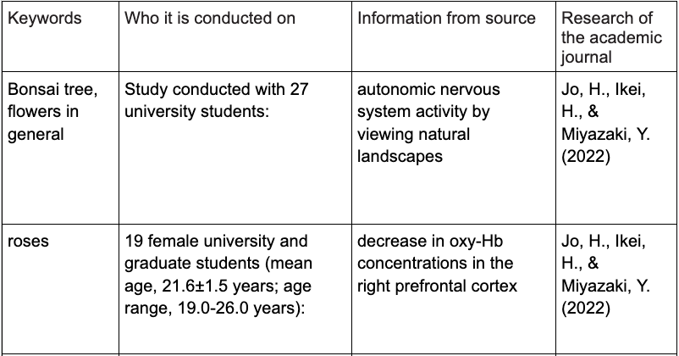
(1) research characteristics
bonsai trees
AI
Grass/ Plants
Forest
+50 images
generated by AI
Roses
blues/ greens

Slide 12

(*) assessment and insignts
7
5
6
AI
10
7
10
AI
8
9
6
+50 Images
(scores images based on research)
keywords
(text to image generation)
+500 images
description

Slide 13
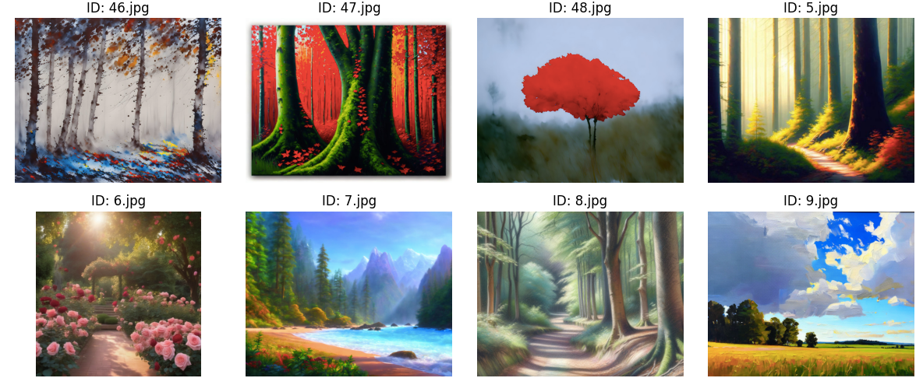
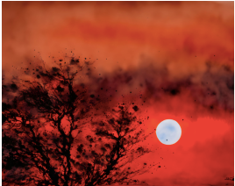
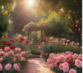
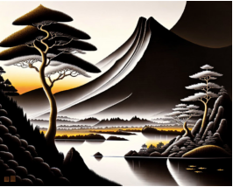
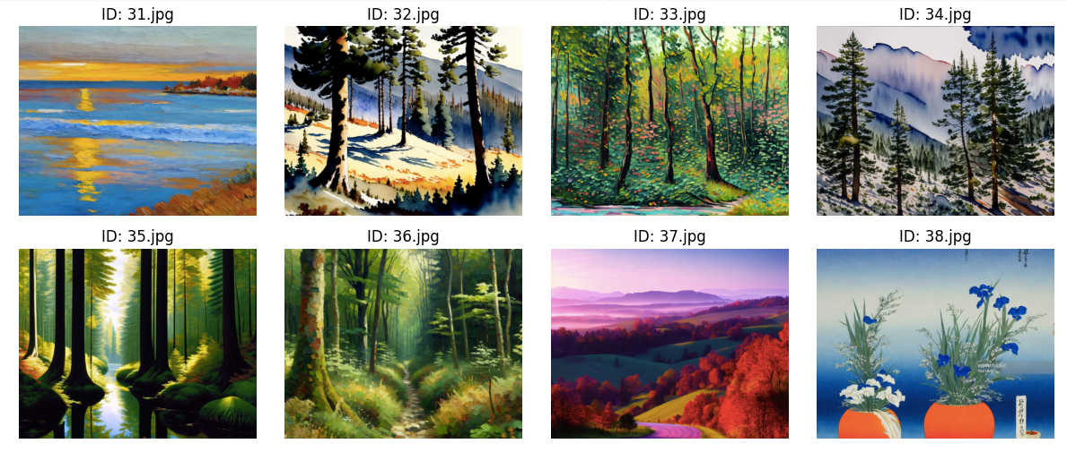
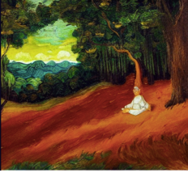
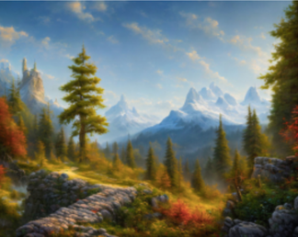
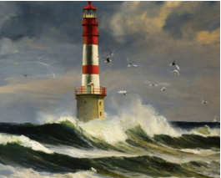
The scores of the images (assessment)
A: 7
B: 6
A: 2
B: 3
A: 3
B: 2
A: 9
B: 8
A: 3
B: 1
A: rate this image based on how much it matches [ the desciption of my research ] on 1-10
(description of research here)
A:9
B: 8
A: 7
B: 8
A: 8
B: 8
A: 7
B: 8
A: 3
B: 2
A: 7
B: 6
A: 6
B: 8
A: 8
B: 8
A: 7
B: 7
A: 7
B: 6
B: rate this image for it’s calmness and ability to improve mood on 1-10
A: 9
B: 9
A: 9
B: 9
A: 8
B: 9
A: 7
B: 8
A: 3
B: 2

Slide 14
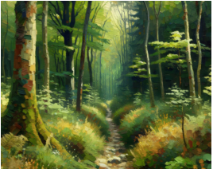
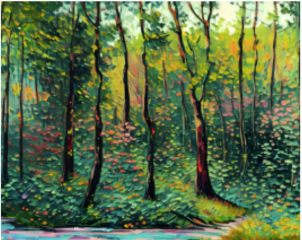
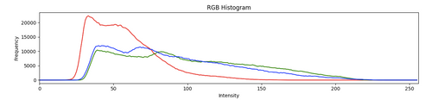
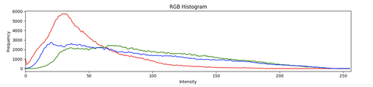

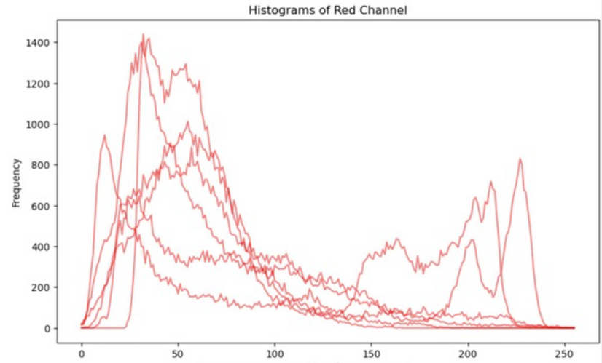
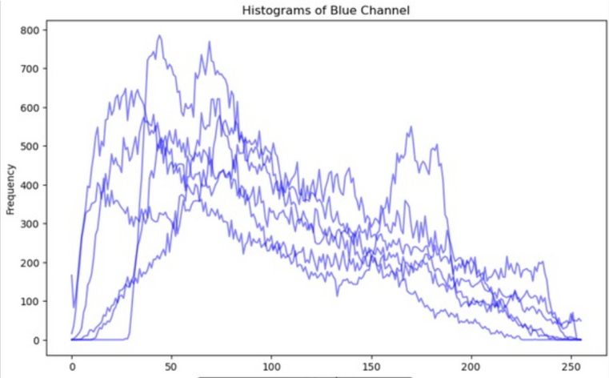
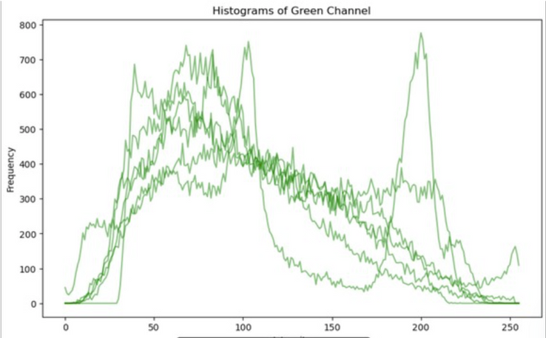
Histogram (assessment)
x= color intensity
y= number color pixels
A histogram of color pixels of multiple images with high score of both A & B

Slide 15
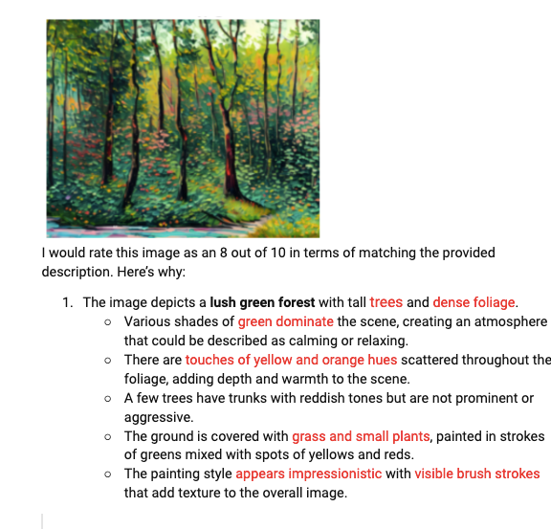
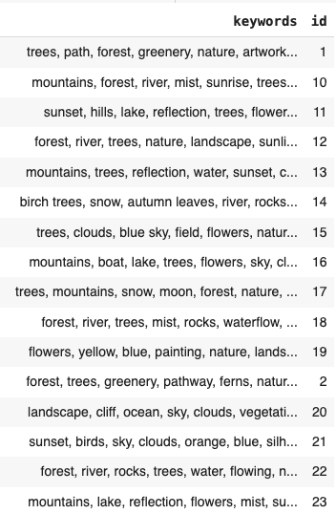
Keywords generation
PROMPT
ANSWER FROM AI
DESCRIPTION> KEYWORDS
rate from 1-10 on how much this matches the description of: containing predominantly blues and greens, limited existence of bright red, containing either forest, roses, bonsai trees, foliage plants, flowers, mountains as subject matter.
(A)
river
greenery
vegetation
Lake

Slide 16
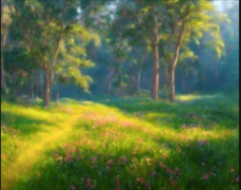
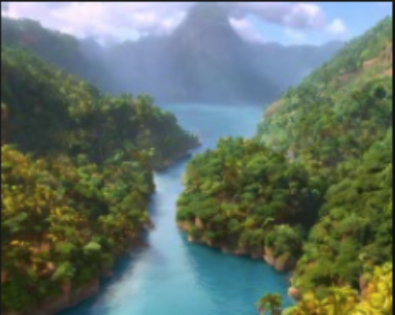
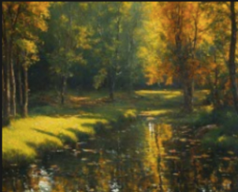
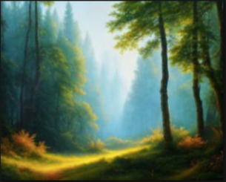
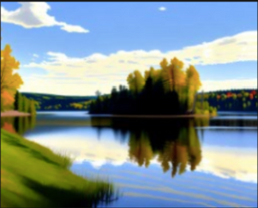
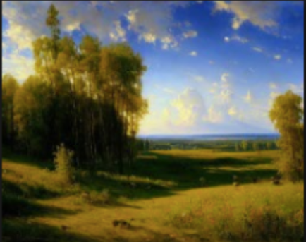
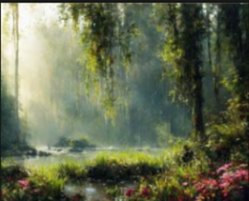
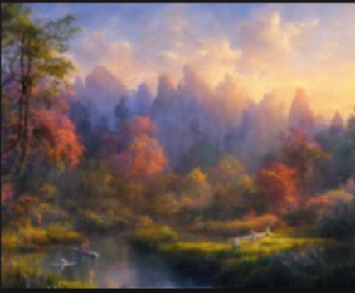
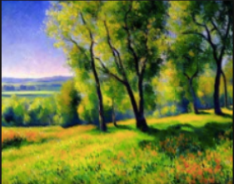
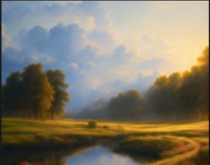
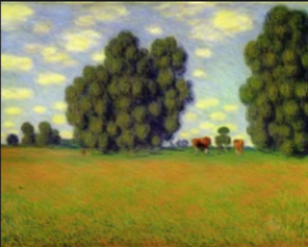
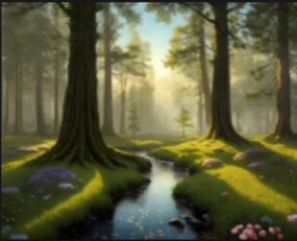
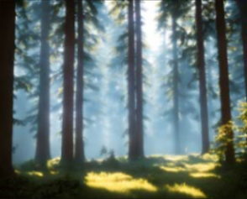
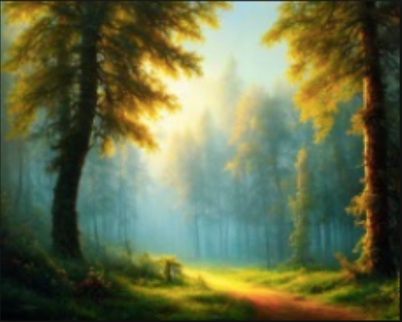
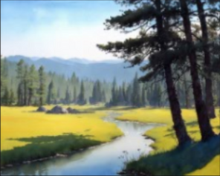
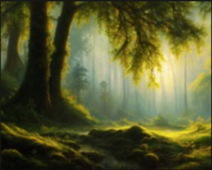
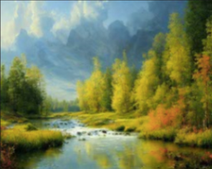
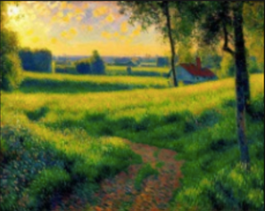
More image geneneration (+500)
Having more AI images are generated for the GAN based on the keys words

Slide 17
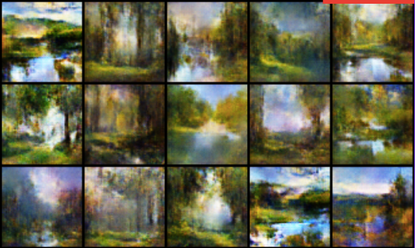


GAN
real
noise
generator
discriminator
fake
real data

Slide 18
More image geneneration (+500)
Having more AI images are generated for the GAN based on the keys words

Slide 19
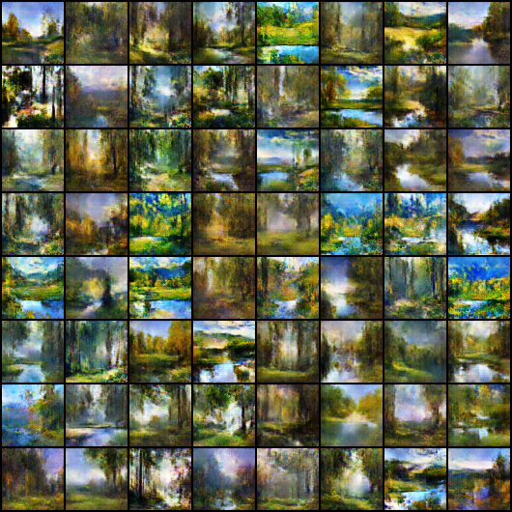
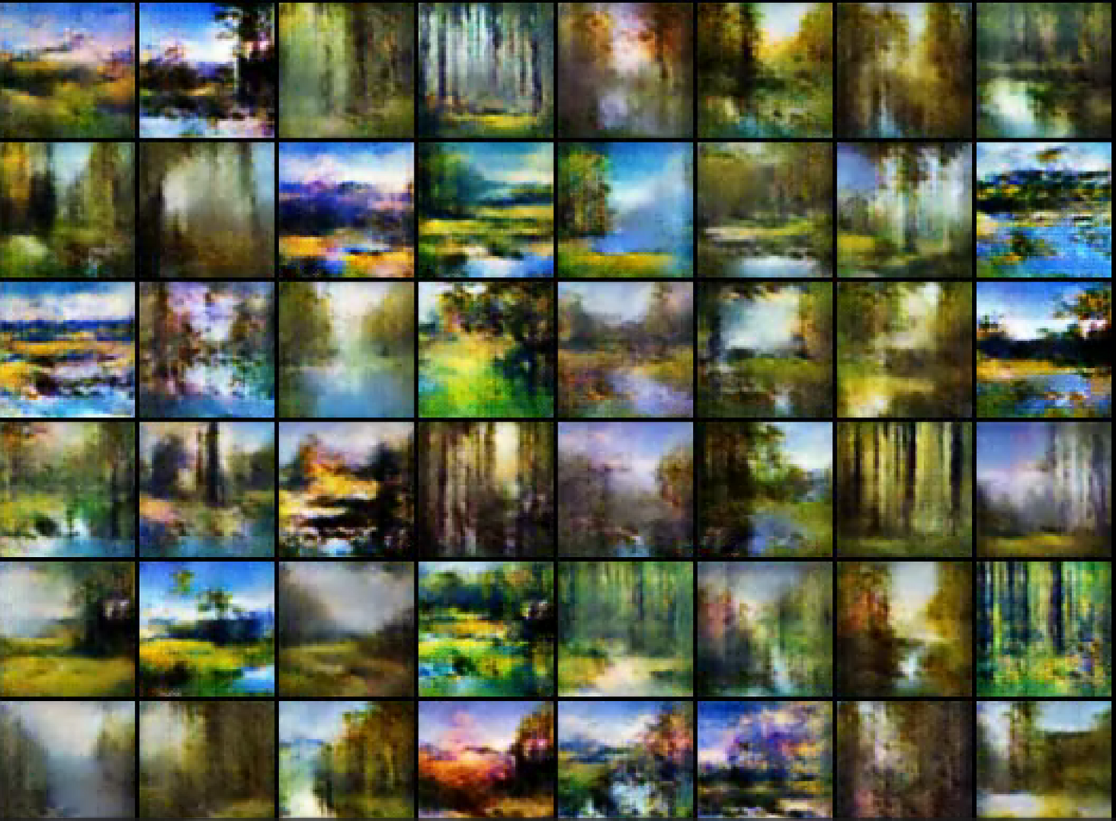
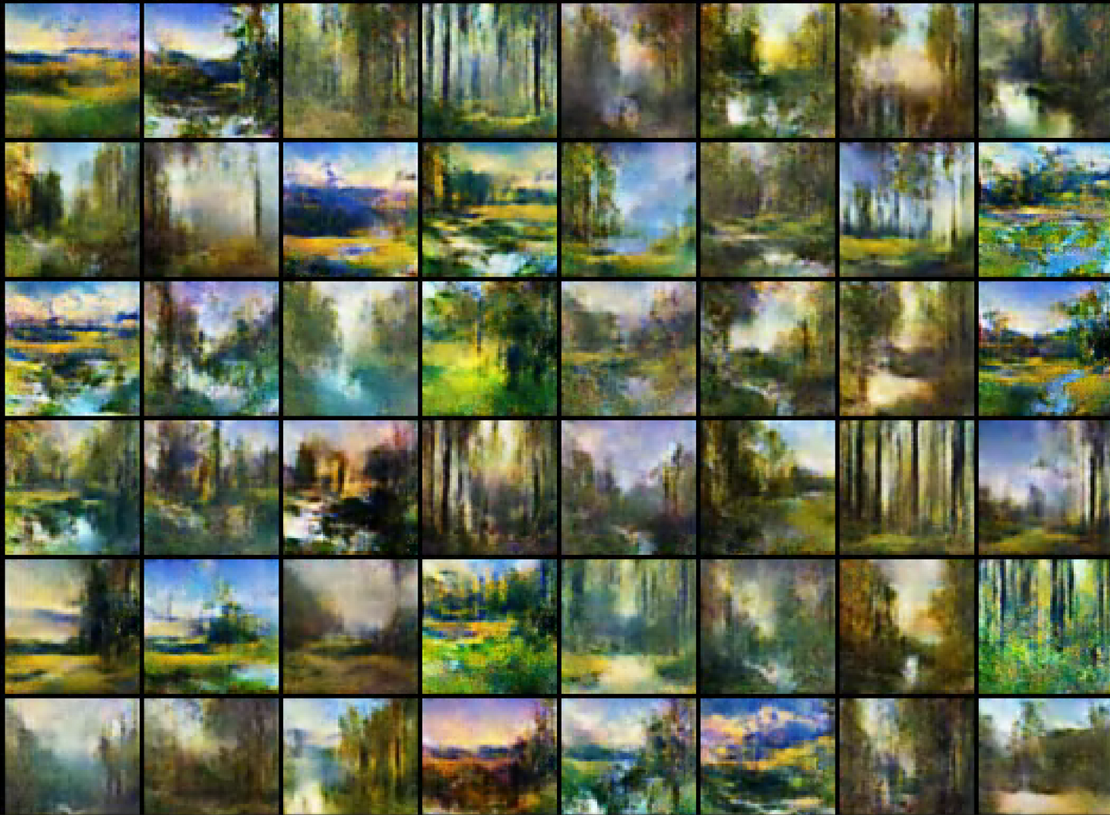

Slide 20














A
B
C
D

Slide 21



Cycle GAN
D

Slide 22




A
A
A
A
input images
generator
output images
B
B
B
B

Slide 23









A
B
A
B
A
B

Slide 24

A
B
A
B

Slide 25
A
B
A
B

Slide 26

A
B
A
B

Slide 27
Limitations
-There are more sophisticated methods, such as stable diffusion where quality of the image could be better.
-I have limited skills and timeframe in the project more methods can be explored
-Although being backed up with research, what makes an image calming is subject
Outlook in general
LEARNING FROM THE DESIGNS THAT YOU HAVE DIRECTLY SELECT
-Use insights of the histogram to help the model to train better

Slide 28
Summary

Slide 29



Slide 30
Thank you.

